Slide 1


Department of Computer Science & Engineering
Project Work - II

Slide 2


Analytics Tool Adobe Experience/Launch
Presented By - Mohith H Pillai (EN19CS303032)
Project Guide – Mr. Gaurav Sharma (Assistant Professor)
Medi-Caps University, Indore

Slide 3
Abstract
Adobe Launch is a Data Analytics tool developed by Adobe Inc. It is designed to help teams plan, test, and manage projects efficiently. Adobe Launch is widely used by analyst teams, to create dashboards, test sites and apps data tracking.
The purpose of this report is to provide an overview of Adobe Launch, a Data analytics tool used by organizations worldwide. The report covers the various features of Adobe, how it works, and its benefits.

Slide 4
Introduction
Adobe Analytics is a critical aspect of successful project delivery. Effective project management requires the use of appropriate tools and techniques to plan, track, and manage project tasks, resources, and timelines. Adobe Analytics tool is a platform designed to help analysts team to understand the organizational goals and provide them with the best, impactful and easy to understand analytics dashboard.
Adobe Experience Cloud is a web-based application that allows analysts to plan, track, test, and manage their projects in a collaborative and efficient manner. Adobe Experience Cloud is designed to test and validate whether the data is being tracked for websites and apps and create dashboards to represent that data. It is very popular among analysts as it is user friendly and very powerful.

Slide 5
Problem Statement
The widespread problem of Businesses or Organizations is understanding their customers, analysing their behaviour, which is difficult without data collection and analysing that data, which will help organizations to further improve their products or understand where the users are facing problems.

Slide 6
Solution Domain
In recent years, data analytics has become increasingly popular due to their ability to easily collect data.
Adobe Experience is the platform which provides these and other features for analysts to fulfil organization goals. Adobe provides a range of features to test and validate data, create dashboard, data analysis, and understand traffic of websites and apps.
The objective of this report is to provide a comprehensive overview of Adobe Experience, a data analytics tool developed by Adobe Inc. The report aims to provide an understanding of the key features of Adobe Experience, how it works, and its benefits.

Slide 7
System Domain
Adobe Analytics tool can work with mobile and tablets of both operating system including iOS and Android with their minimum version's. Adobe Analytics tool requires only internet connection with minimum connectivity.

Slide 8
Application Domain
Adobe Analytics tool is used for various purposes:
1. It is a comprehensive content management solution for building websites, mobile apps, and forms.
2. Manage your marketing content and assets.
3. Easy data collection and data analytics.

Slide 9
Expected Outcome-
Adobe Analytics tool helps an analyst to discover whether the data is being tracked for every important user's action. So that the organizations can better understand their customers and provide them a better experience.

Slide 10
Non-Functional Requirements
Reliability and availability- Out server is available 24 X 7 user can access it any time. There is no such dependency of time.
Security- The data will remain secure.
Maintainability- The projects are easily maintainable and manageable
Compatible- There is no such extra hardware required to run this project. It can work fine with normal configurations (64-bit processor and 4 GB ram)
Usable and Scalable- Very simple and user-friendly UI is designed so user will not find any difficulty in using this project.

Slide 11
System Requirements
Supported Browsers:
Windows : Google Chrome, Microsoft Edge, Firefox
MacOS : Google Chrome, Safari, Firefox
Hardware Specifications:
Processor 64-bit, four-core, 2.5 GHz minimum per core.
RAM 4 - 8 GB for smooth working of Adobe platform.

Slide 12
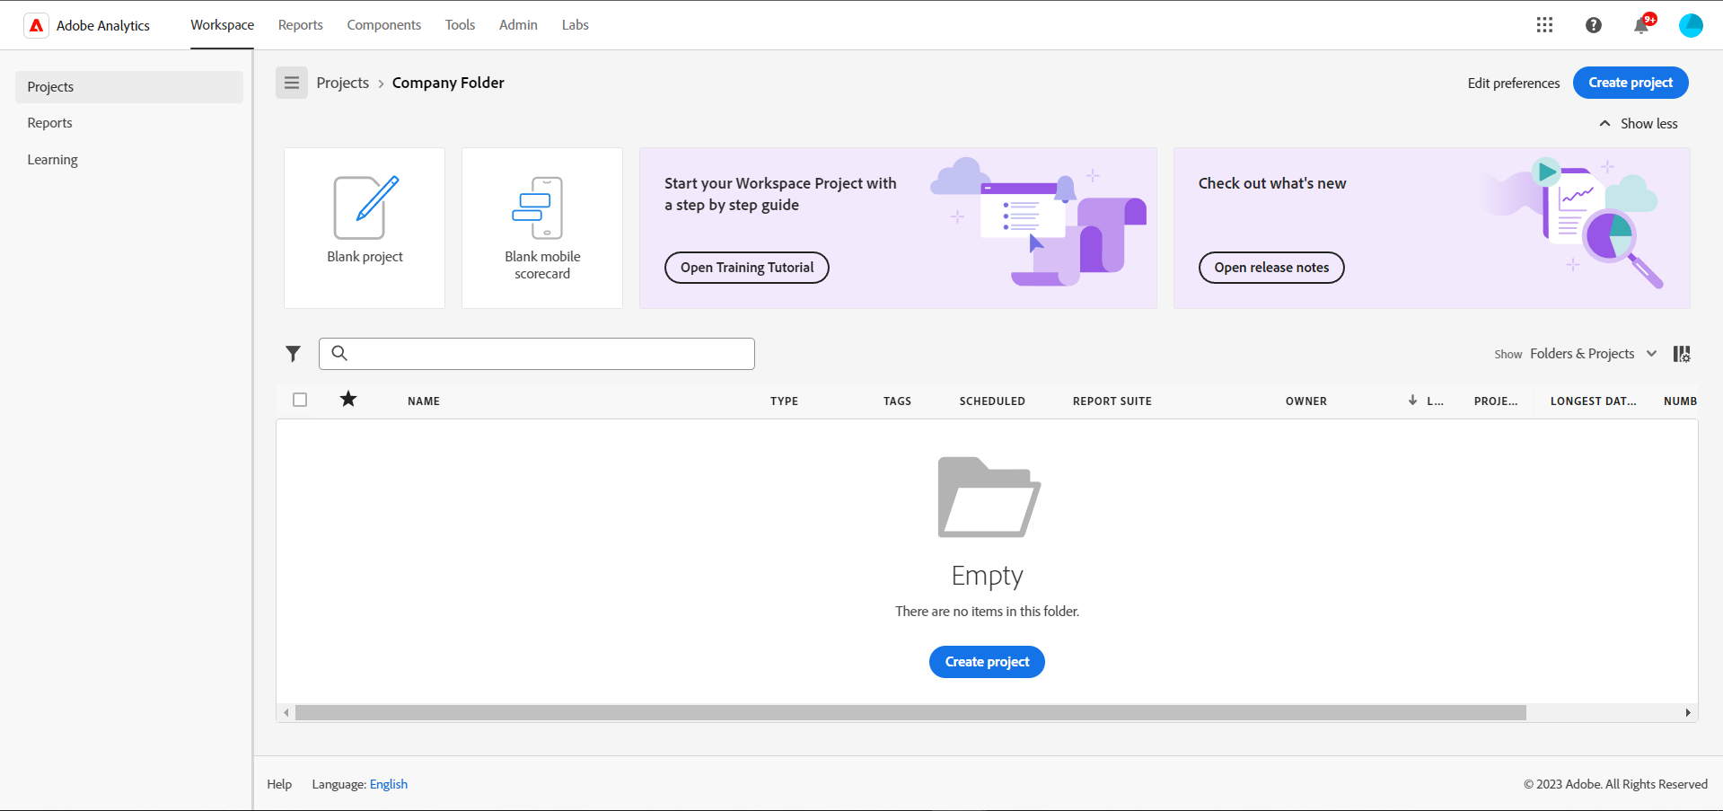
User Interface – Project Index Page

Slide 13
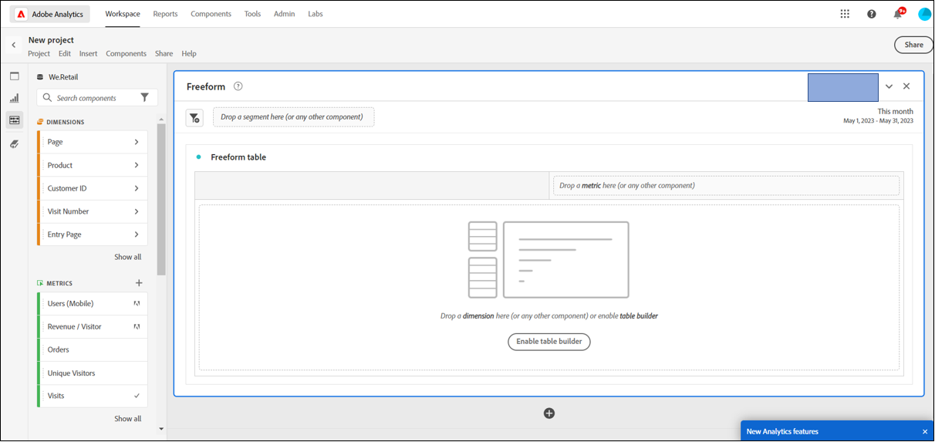
New Project Interace

Slide 14
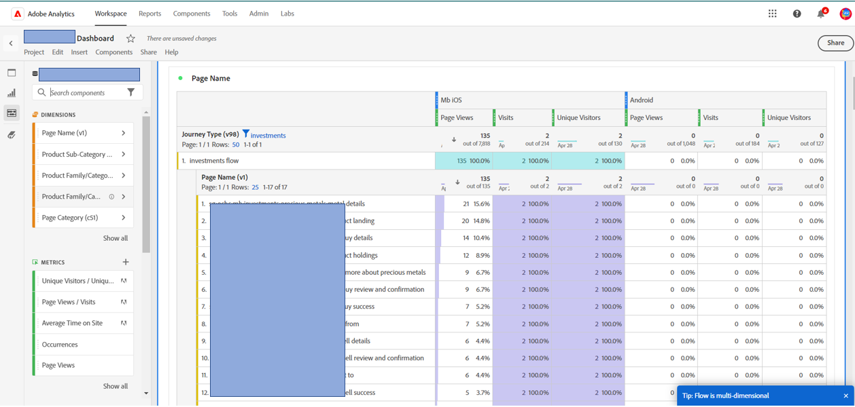
Dashboard Page Loads

Slide 15
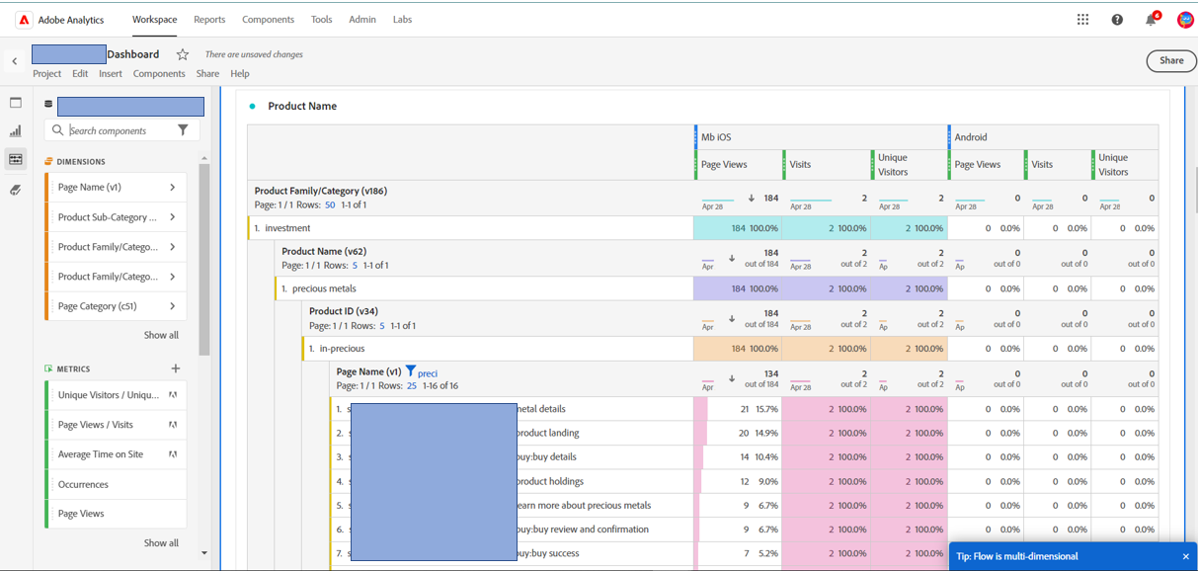
Dashboard Product Hierarchy

Slide 16
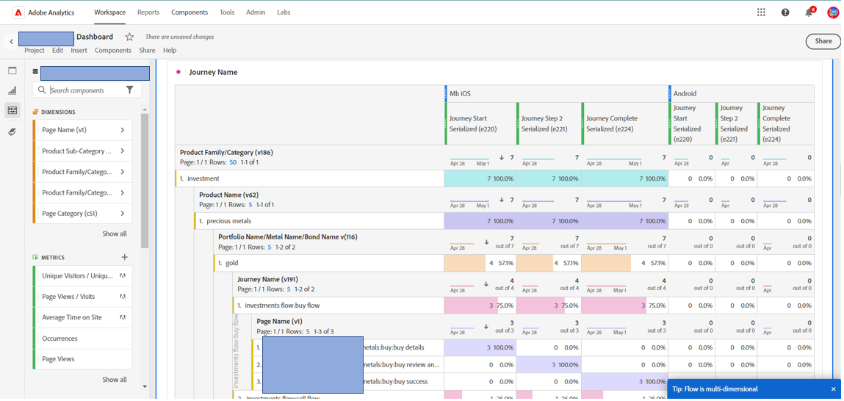
Dashboard Journey Tracking

Slide 17
Methodology
The process can be divided into following stages-
Flow Understanding
Technical Support Document Creation
Testing on websites
Adobe Dashboard and Testing
Resend for corrections
Retesting and Evaluation

Slide 18
Future Scope
Adobe AEM is rising rapidly and probably become one of the top job sectors in the coming years. A minimum of the next 5-10 years, AEM will certainly be in excessive demand. With each release, Adobe is striving to make AEM development less complicated, and therefore the need for genuine AEM designers is on the rage.

Slide 19
Conclusion
The AEP is one of the most preferred platforms for analytics, it is easy to use and has a lot of features which makes analysis easy, quick, and efficient. AEP was used in this project to create meaningful and easy to understand dashboards and track issues with websites and apps. Through AEP, which has a lot of features, we were able to learn about Adobe Launch, whose functionalities has been discussed in the report, providing an API- first design, which allows scripting to automate technology deployments, publishing workflows, data collection and sharing and more.
Overall, we were successful in creating a dashboard that provides a comprehensive solution for issue tracking and data analysis. AEP can manage multiple projects with customizable workflows and dashboards, making it an effective tool for data analysis.

Slide 20
References & Bibliography
Adobe Experience Platform. (2021) Retrieved from https://business.adobe.com/in/products/experience-platform/launch.html
Adobe Analytics. (2022). Retrieved from https://business.adobe.com/in/products/analytics/adobe-analytics.html
Tag Management System. (2021). Retrieved from https://digitalmarketing.grazitti.com/blog/how-to-implement-configure-adobe-launch/#:~:text=Adobe%20Launch%20is%20the%20next,based%20on%20your%20organization's%20needs.
Functionalities of Adobe Launch. (2021). Retrieved from https://www.nabler.com/adobe-analytics/articles/5-ways-make-most-out-of-adobe-launch/

